Slide 1


Modern Operating Systems
Fifth Edition
Chapter 12
Operating System Design
Copyright © 2023, 2014, 2008 Pearson Education, Inc. All Rights Reserved
Notes:
If this PowerPoint presentation contains mathematical equations, you may need to check that your computer has the following installed:
1) Math Type Plugin
2) Math Player (free versions available)
3) NVDA Reader (free versions available)

Slide 2
Operating System Goals
Define abstractions
Provide primitive operations
Ensure isolation
Manage the hardware

Slide 3
Difficulties Designing an Operating System (1)
Operating systems have become extremely large programs
Must deal with concurrency
Have to deal with potentially hostile users
Many users want to share some of their information and resources with selected other users

Slide 4
Difficulties Designing an Operating System (2)
Operating systems live for a very long time
Designers need to provide for considerable generality
Systems are generally designed to be portable
Operating systems need to be backward compatible with some previous operating system

Slide 5
Guiding Principles for Interface Design
Simplicity
Perfection is reached not when there is no longer anything to add, but when there is no longer anything to take away. (Antoine de St. Exupery)
Completeness
Everything should be as simple as possible, but no simpler. (Albert Einstein)
Efficiency
If a feature or system call cannot be implemented efficiently, it is probably not worth having (Andrew Tanenbaum)

Slide 6
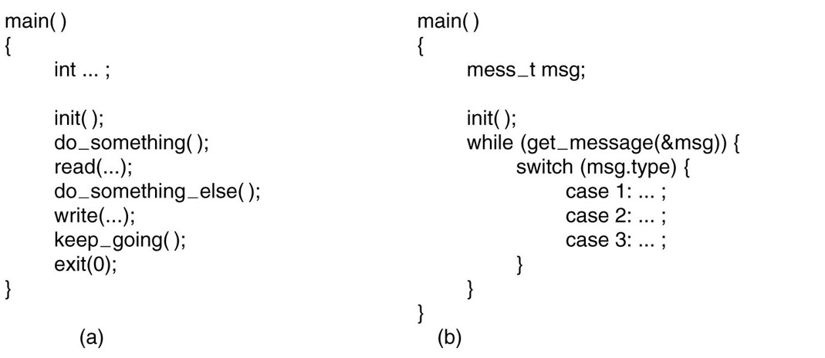
Execution Paradigms
Figure 12.1 (a) Algorithmic code. (b) Event-driven code.
Notes:
Long Description:
The 11 lines of code for figure (a) are as follow main open close parenthesis open curly bracket int ellipsis semicolon init open close parenthesis semicolon do underscore something open close parenthesis semicolon read open parenthesis ellipsis close parenthesis semicolon do underscore something underscore else open close parenthesis semicolon write open parenthesis ellipsis close parenthesis semicolon keep underscore going open close parenthesis semicolon exit open parenthesis 0 close parenthesis semicolon close curly bracket The 12 lines of code for figure (b) are as follow main open close parenthesis open curly bracket mess underscore t m s g semicolon init open close parenthesis semicolon while open parenthesis get underscore message open parenthesis ampersand m s g close parenthesis close parenthesis open curly bracket switch open parenthesis m s g dot type close parenthesis open curly bracket case 1 colon case 2 colon ellipsis case 3 colon dot close curly bracket close curly bracket close curly bracket

Slide 7
System Structure
Layered Systems
Exokernels
Microkernel-Based Client-Server Systems
Extensible Systems
Kernel Threads

Slide 8
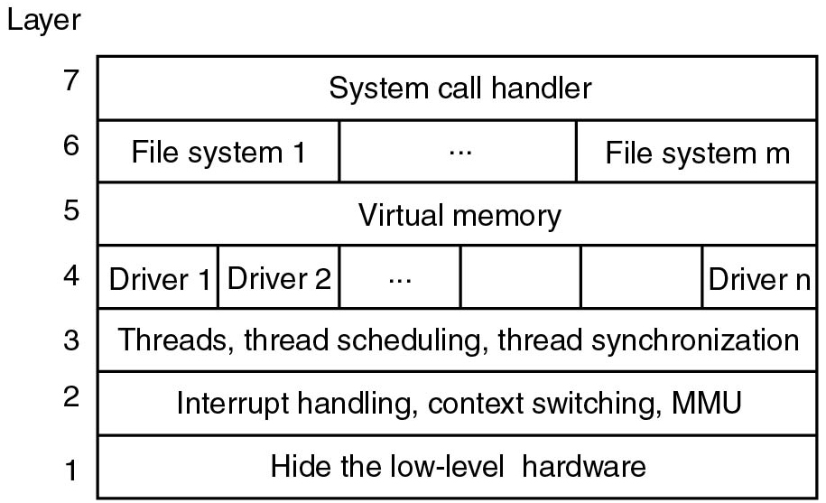
Layered Systems
Figure 12.2 One possible design for a modern layered operating system.
Notes:
Long Description:
The figure consists of a block divided horizontally into seven layers and numbered from bottom to top as 1 to 7. The layers are given as follows. layer 1: Hide the low-level hardware. layer 2: Interrupt handling, context switching, M M U. layer 3: Threads, thread scheduling, thread synchronization. layer 4: It is divided into n number of parts labeled Driver 1, driver 2, up to driver n. layer 5: Virtual memory. layer 6: It is divided into m number of parts labeled file system 1, up to file system m. layer 7: System call handler.

Slide 9
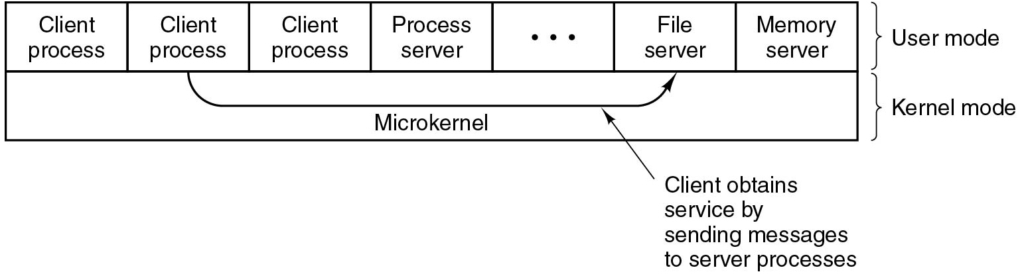
Microkernel-Based Client-Server Systems
Figure 12.3 Client-server computing based on a microkernel.
Notes:
Long Description:
The figure consists of a block divided horizontally into two segments labeled user mode and kernel mode. The user-mode consists of seven parts labeled from left to right as follows. Client process, client process, client process, process server, blank, file server, memory server. The second segment consists of a microkernel that connected the second client process to the file server. It represents the client obtains service by sending messages to server processes.

Slide 10
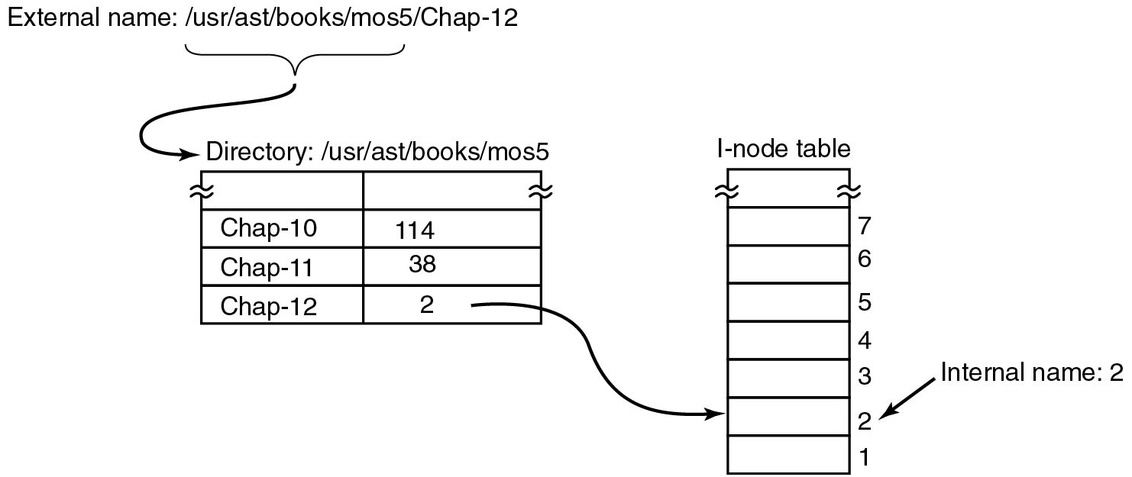
Naming
Figure 12.4 Directories are used to map external names onto internal names.
Notes:
Long Description:
The figure contains two parts. The first part consists of a block labeled Directory: slash u s r slash a s t slash books slash m o s 5. It is given from an external name labeled slash u s r slash a s t slash books slash m o s 5 slash Chap 12. The block consists of two columns and four rows. The row entries are as follows. Row 1: column 1, blank. column 2, blank. Row 2: column 1, chap 10. column 2, 114. Row 3: column 1, chap 11. column 2, 38. Row 4: column 1, chap 12. column 2, 2. The second part consists of another block labeled I node table which contains 8 rows labeled from bottom to top. An arrow points from column 2 of the third row in the first block to row 2 of the second block. Row 2 in the second block is labeled internal name: 2.

Slide 11
Binding Time
Early binding
Simple
but less flexible
Late binding
More complicated
but more flexible

Slide 12
Static versus. Dynamic Structures
found = 0;
for (p = &proc table[0]; p < &proc table[PROC TABLE SIZE]; p++) {
if (p->proc p i d == p i d) {
found = 1;
break;
}
}
Figure 12.5 Code for searching the process table for a given P I D.

Slide 13
Useful Techniques
Hiding the Hardware
Indirection
Reusability
Reentrancy
Brute Force
Check for Errors First

Slide 14
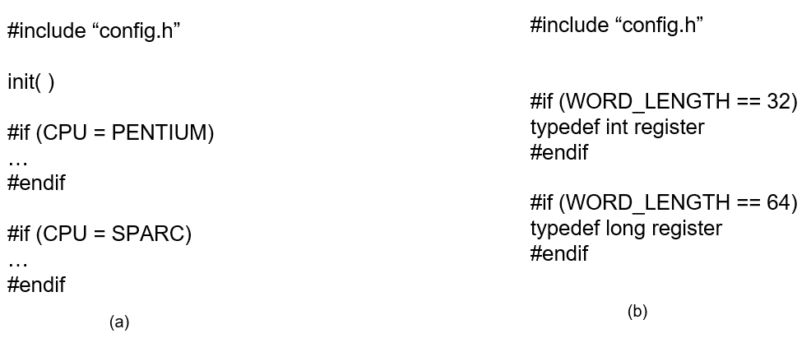
Hiding the Hardware
Figure 12.6 (a) C P U-dependent compilation. (b) Word-length dependent conditional compilation.
Notes:
Long Description:
The 8 lines of code for figure (a) are as follows:
hash include double quote config dot h double quote
init open parenthesis close parenthesis
hash if open parenthesis C P U equals PENTIUM close parenthesis
ellipsis
hash endif
hash if open parenthesis C P U equals SPARC close parenthesis
ellipsis
hash endif

Slide 15
Performance
Why Are Operating Systems Slow?
What Should Be Optimized?
Space-Time Trade-offs
Caching
Hints
Exploiting Locality
Optimize the Common Case

Slide 16
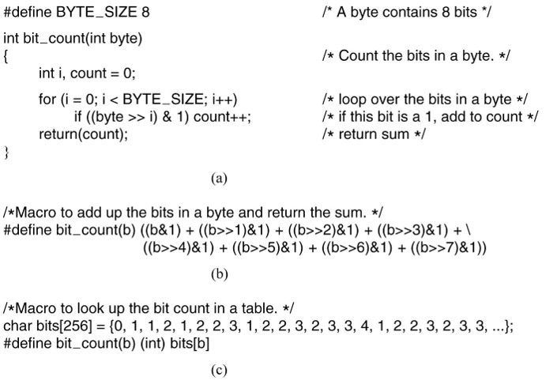
Space-Time Tradeoffs (1 of 2)
Figure 12.7 (a) A procedure for counting bits in a byte. (b) A macro to count the bits. (c) Table look up.
Notes:
Long Description:
The 9 lines of code for figure (a) are as follows: hash define BYTE underscore SIZE 8 forward slash asterisk A byte contains 8 bits int bit underscore count open parenthesis int byte close parenthesis open curly bracket forward slash asterisk Count the bits in a byte dot asterisk forward slash int i comma count equals to 0 semicolon for open parenthesis i equals to 0 semicolon i less than BYTE underscore SIZE semicolon i plus plus close parenthesis forward slash asterisk loop over the bits in a byte asterisk forward slash if open parenthesis open parenthesis byte extraction operator i close parenthesis ampersand 1 close parenthesis count plus plus semicolon forward slash asterisk if this bit is a 1 comma add to count asterisk forward slash return open parenthesis count close parenthesis semicolon forward slash asterisk return sum asterisk forward slash close curly bracket.

Slide 17
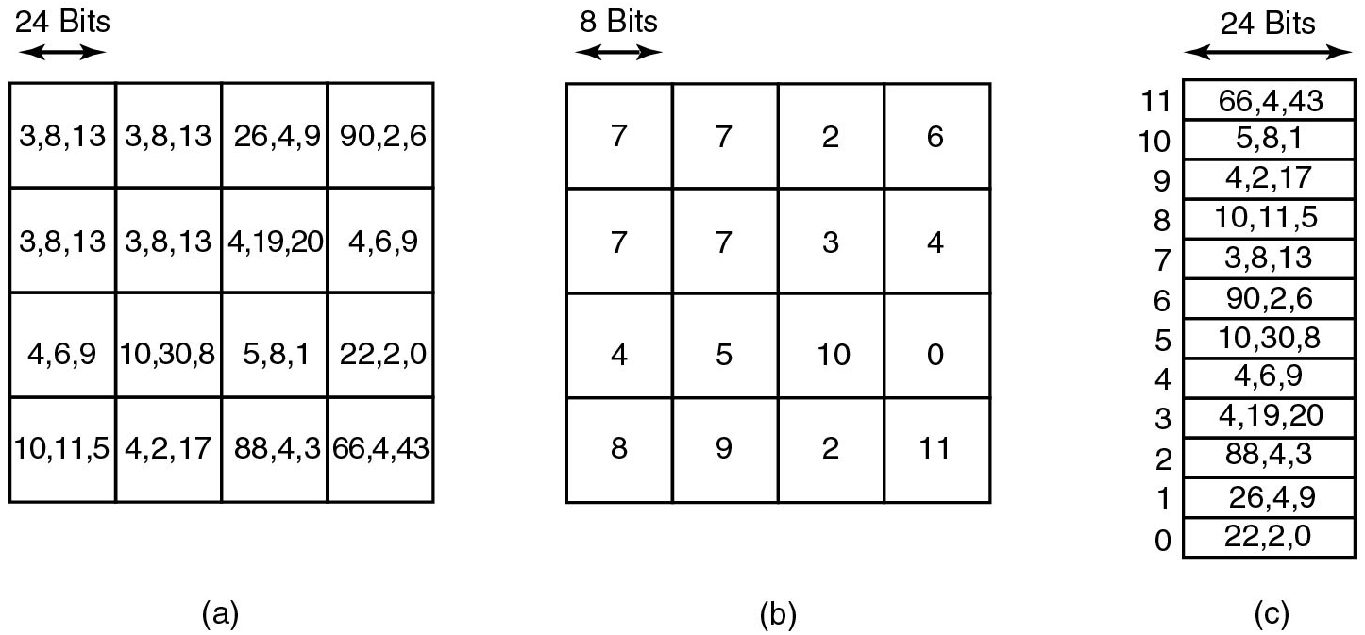
Space-Time Tradeoffs (2 of 2)
Figure 12.8 (a) Part of an uncompressed image with 24 bits per pixel. (b) With a palette (c) The palette.
Notes:
Long Description:
Figure a: It contains a block divided into four rows and four columns. Each column is of 24 bit. The row and column entries are as follows. Row 1: Column 1: 3, 8, 13. Column 2: 3, 8, 13. Column 3: 26, 4, 9. Column 4: 90, 2, 6. Row 2: Column 1: 3, 8, 13. Column 2: 3, 8, 13. Column 3: 4, 19, 20. Column 4: 4, 6, 9. Row 3: Column 1: 4, 6, 9. Column 2: 10, 30, 8. Column 3: 5, 8, 1. Column 4: 22, 2, 0. Row 4: Column 1: 10, 11, 5. Column 2: 4, 2, 17. Column 3: 88, 4, 3. Column 4: 66, 4, 43. Figure b: It contains a block divided into four rows and four columns. Each column is of 8 bits. The row and column entries are as follows. Row 1: Column 1, 7. Column 2, 7. Column 3, 2. Column 4, 6. Row 2: Column 1, 7. Column 2, 7. Column 3, 3. Column 4, 4. Row 3: Column 1, 4. Column 2, 5. Column 3, 10. Column 4, 0. Row 4: Column 1, 8. Column 2, 9. Column 3, 2. Column 4, 11. Figure c: It contains a block divided into twelve rows. Each row is of 24 bits. The row entries from bottom are as follows. Row 0: 22, 2, 0. Row 1: 26, 4, 9. Row 2: 88, 4, 3. Row 3: 4, 19, 20. Row 4: 4, 6, 9. Row 5: 10, 30, 8. Row 6: 90, 2, 6. Row 7: 3, 8, 13. Row 8: 10, 11, 5. Row 9: 4, 2, 17. Row 10: 5, 8, 1. Row 11: 66, 4, 43

Slide 18
Caching (1 of 2)
To look up /u s r/a s t/m box (Fig. 4.35) requires the following disk accesses:
Read the i-node for the root directory (i-node
Read the root directory (block 1)
Read the i-node for /u s r (i-node 6)
Read the /u s r directory (block 132)
Read the i-node for /u s r/a s t (i-node 26)
Read the /u s r/a s t directory (block 406)

Slide 19
Caching (2 of 2)
Path | I-node number
/u s r | 6
/u s r/a s t | 26
/u s r/a s t/m box | 60
/u s r/a s t/books | 92
/u s r/bal | 45
/u s r/bal/paper.p s | 85
Figure 12.9 Part of the i-node cache.

Slide 20
Project Management: The Mythical Man Month
Large project design
One-third Planning
One-sixth Coding
Quarter Module testing
Quarter System testing
People and time not interchangeable
Work cannot be fully parallelized
Work must be partitioned into large numbers of modules
Debugging is highly sequential
It takes 9 months to bear a child, no matter how many women you assign to the project

Slide 21
Team Structure
Title | Duties
Chief programmer | Performs the architectural design and writes the code
Copilot | Helps the chief programmer and serves as a sounding board
Administrator | Manages the people, budget, space, equipment, reporting, etc.
Editor | Edits the documentation, which must be written by the chief programmer
Secretaries | The administrator and editor each need a secretary
Program clerk | Maintains the code and documentation archives
Toolsmith | Provides any tools the chief programmer needs
Tester | Tests the chief programmer’s code
Language lawyer | Part timer who can advise the chief programmer on the language
Figure 12.10 Mills’ proposal for populating a 10-person chief programmer team.

Slide 22
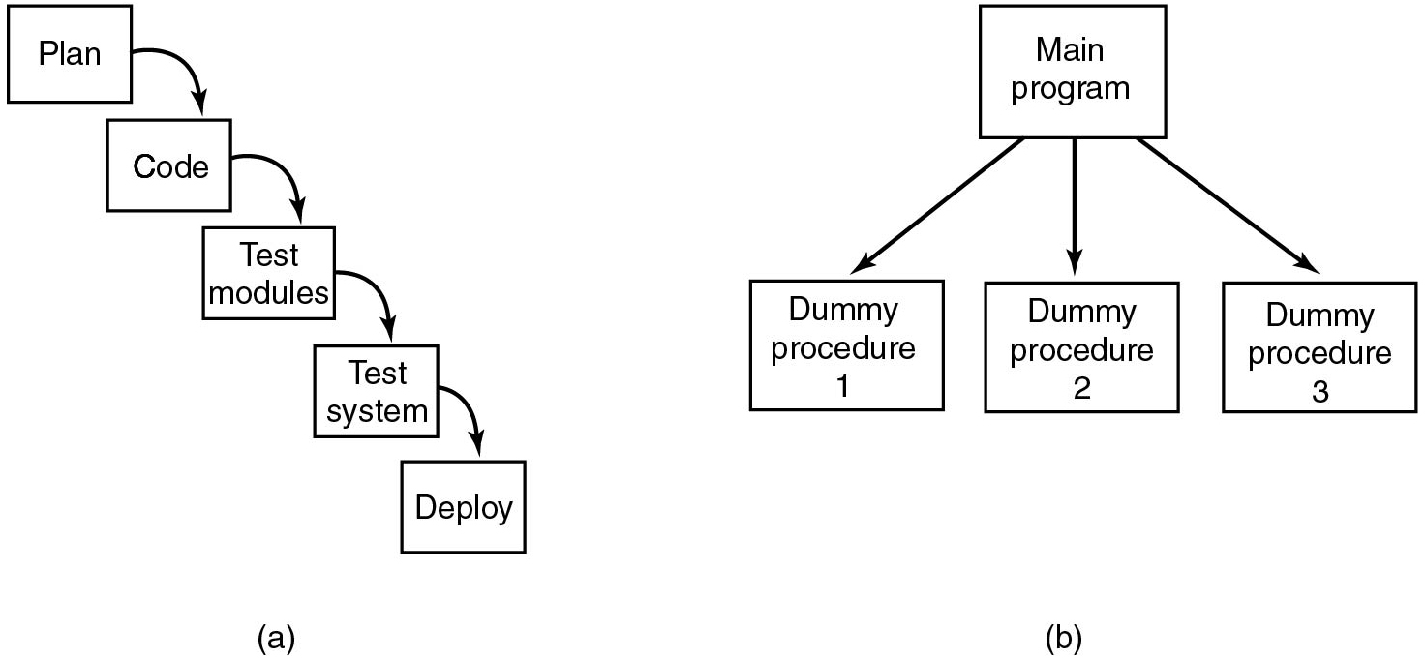
The Role of Experience
Figure 12.11 (a) Traditional software design progresses in stages. (b) Alternative design produces a working system (that does nothing) starting on day 1.
Notes:
Long Description:
Figure a: It contains a set of five blocks arranged from top to bottom in an inclined manner and connected by arrows from top to bottom. The blocks are given as follows. Plan, Code, Test modules, Test system, Deploy. Figure b: It consists of a block labeled main memory which is classified into three blocks labeled Dummy procedure 1, Dummy procedure 2, Dummy procedure 3.

Slide 23
Trends in Operating Systems
Virtualization
Multicore Chips
Large Address Space Operating Systems
Networking
Parallel and Distributed Systems
Multimedia
Battery-Powered Computers
Embedded Systems
Sensor Nodes

Slide 24

Copyright
This work is protected by United States copyright laws and is provided solely for the use of instructors in teaching their courses and assessing student learning. Dissemination or sale of any part of this work (including on the World Wide Web) will destroy the integrity of the work and is not permitted. The work and materials from it should never be made available to students except by instructors using the accompanying text in their classes. All recipients of this work are expected to abide by these restrictions and to honor the intended pedagogical purposes and the needs of other instructors who rely on these materials.

